Slide 1
Invisible Cities – Air Quality

Slide 2
Group 3 members
Qiuwen Ju
Tom Keel
Zixin Lyu
Jay Wilson

Slide 3
Qiuwen Ju – street pollution
Qiuwen Ju

Slide 4
Tom Keel – spinning globe
Tom Keel

Slide 5
Zixin Lyu – API map
Zixin Lyu

Slide 6
Jay Wilson – Copernicus
Jay Wilson

Slide 7
Website
https://determined-bohr-fab812.netlify.com/

Slide 8

Question time?

Slide 9
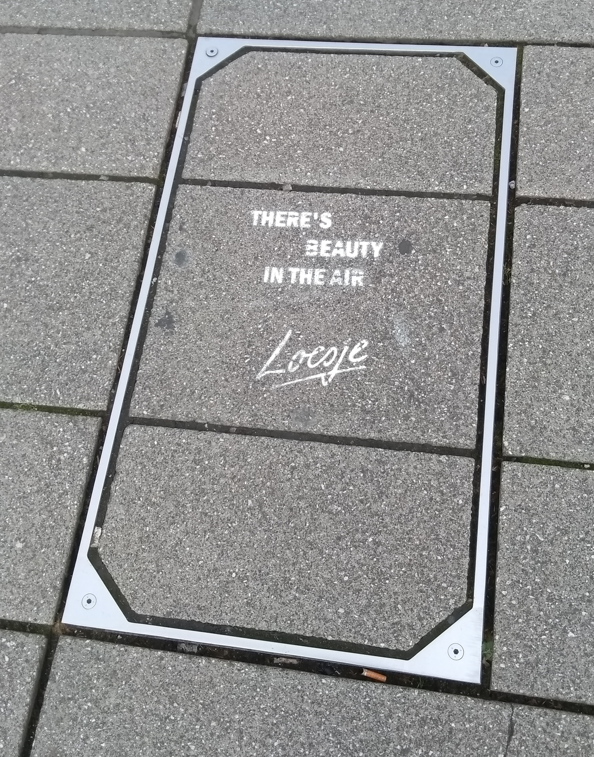
Question time!

